Slide 1
THIS is fine: Firefighting for the DBA
Matt Gordon

Slide 2







A big thank you to our sponsors for making today possible!

Slide 3


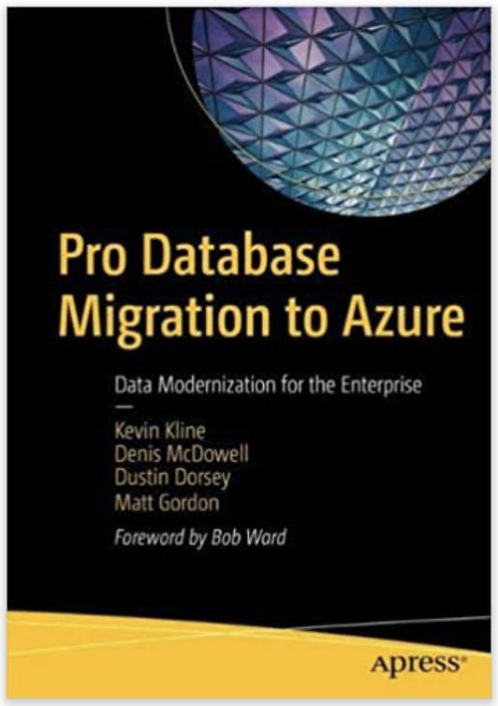
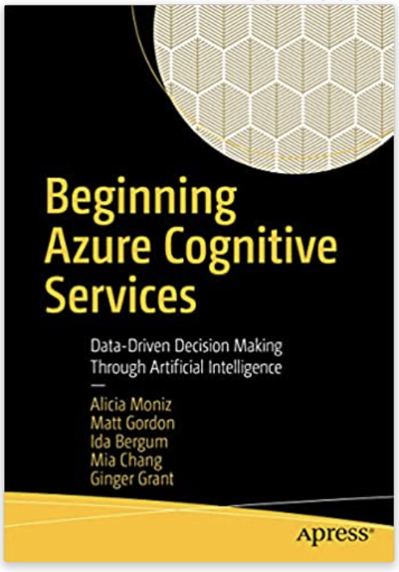
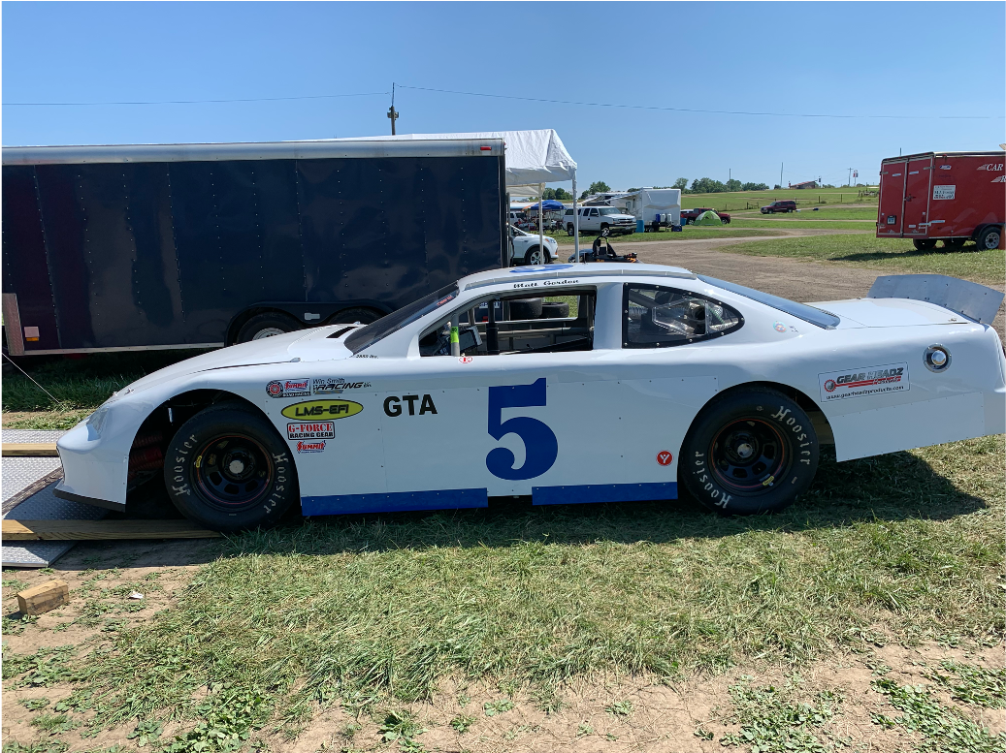
Matt Gordon
Director of Cloud Administration
matt@sqlatspeed.com
: @sqlatspeed
www.sqlatspeed.com

Slide 4
LOOKING FOR A NEW JOB?
CLOUD DATA ADMINISTRATOR
CLOUD Infrastructure ADMINISTRATOR

Slide 5


QR CODES FOR JOB LINKS
Cloud Administrator
Cloud Data Administrator

Slide 6


About me
20+ years of SQL Server experience
Microsoft Data Platform MVP
Friend of Redgate
Managed 24x7 datacenters
Leader of Lexington, KY (USA) Data Technology Group

Slide 7



Notes:
Remind how the original webcomic (”On Fire” by KC Green) does not end well for the dog – we don’t want to be the dog

Slide 8
WHAT DOES “FINE” MEAN?
Do you baseline your SQL Server databases?
Is your baseline data-driven or gut feel?
How can we baseline our databases?

Slide 9
How do we baseline our databases?
Third-party tools
Solarwinds sql sentry (aka sentryone)
Redgate sql monitor
Idera diagnostic manager

Slide 10
How do we baseline our databases?
Community tools
Glenn berry’s diagnostic queries
SQL Server TIGER TEAM RESOURCES
Brent ozar’s sp_blitz* stored procedures
KEVIN kline’s baselining and monitoring video
Notes:
All links on resource slide

Slide 11
How do we baseline our databases?
Roll your own
perfmon
Dmv queries
Hourly/daily/etc reports on execution times

Slide 12
WHAT Isn’t Fine?
How do we know what’s wrong?
Who/What was the source of the report?
Is it solely a database issue?
Is it a database issue at all?

Slide 13
How TO prove what is (and isn’t) fine?
Sp_whoisactive
Monitoring tools
DMV QUERIES
Performance monitoring with dmvs (Microsoft article)
Wait stats (SQLSKILLS RESOURCES)

Slide 14
How TO prove what is (and isn’t) fine?
Query store!
We can do all this in azure, but azure can do some things as well

Slide 15
What DB Monitoring can azure provide?
Query store!
Query performance insights
Sql insights
In preview as of now

Slide 16
How do we fix what isn’t fine?
State the problem
Identify teams/people involved
Follow process
Profit!
Notes:
CI/CD can be a massive help here because it can often get us out of the finger pointing and research time lost identifying who broke what
Want to be a part of the solution or know someone who does? My company is hiring a DevOps engineer

Slide 17
Are we fine?
Are you feeling your best?
Are you performing at your best?
Baseline yourself
Notes:
”are you feeling your best? & are you performing at your best?” are two different, and sometimes unrelated questions
I have often felt that I was performing at my best during the high of problem solving but it is not true

Slide 18
How do I baseline myself?
Gut feel
Journal
Data
Daylio
@SQLGENE’s SQLBITS SESSION
Notes:
Put link to sqlgene’s blog and link to future bits video here as well

Slide 19
You are not highly available
Proper procedures
Good partners
Advocate for yourself and the team
“superhero complex” isn’t healthy
Find support where you can
https://dataplatformwit.com/data-platform-wit-mental-health-and-wellness-day-2022/

Slide 20
We’re all going to be fine
You’re here!
Make connections
Reach out – many people are ”here” to help
#SQLHELP on twitter
Notes:
The “here” can be virtual as well

Slide 21
The slide where I shill for my books
Cognitive services book
Database migration book

Slide 22
Additional resources
Glenn berry’s diagnostic queries
SQL Server TIGER TEAM RESOURCES
Brent ozar’s sp_blitz* stored procedures
KEVIN kline’s baselining and monitoring video

Slide 23
QR CODES FOR JOB LINKS
Cloud Administrator
Cloud Data Administrator

Slide 24
THANKS FOR ATTENDING!
Matt Gordon
Director of Cloud Administration
matt@sqlatspeed.com
: @sqlatspeed
www.sqlatspeed.com
https://github.com/sqlatspeed/2022_presentations

